Slide 1
Game Server with Socket Programming
- Ashikur Rahman
James Park
- Asif Talukder

Slide 2
Introduction
We programmed a game-server in java
Our game server implements java’s built-in Socket library
Server creates threads for each client it accepts and the connected clients plays against a bot which is located in the server

Slide 3
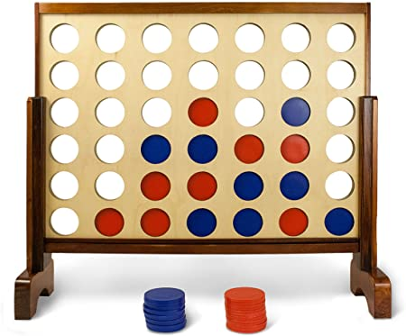
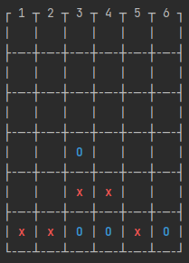
Our example game: Connect 4

Slide 4
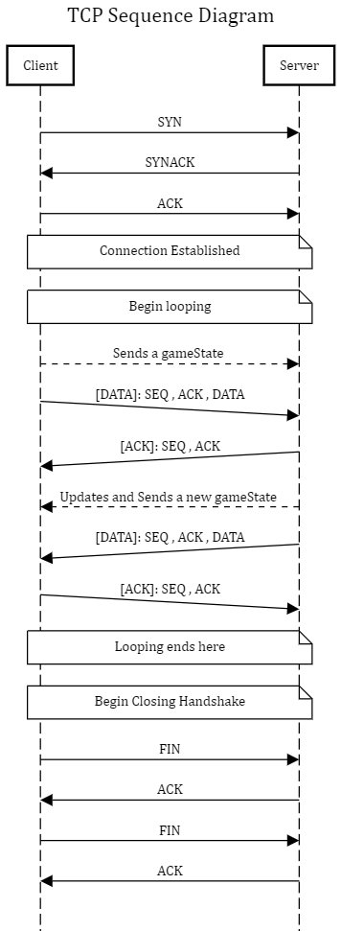
The diagram

Slide 5
Server
Maintains an instance of ServerSocket
Creates individual Socket client ; and creates new thread for each connected client.
Threads Run on a loop to handle incoming Stream of input from the clients
Branches out to different conditional situation depending on predefined input handler: such as, maps the clients names with
Edge Case: Server Crashes on CPU overload , because it creates threads for incoming clients

Slide 6
Client
Creates Socket to connect to the server
Communicates with the server sending the state back and forth , in a loop
Prompts user to make game input : in our case – making a column selection
Edge Case: Client Crashes on Server Downtime, because it tries to create connection to a certain socket, if server doesn’t respond client fails to make a connection.

Slide 7
State Management and Communication
State management is a class, which has instances in the server and in the Game on client-side.
The challenge we faced: line breaks ( ‘\n’ ) will break the stream.
socketStream will see two lines for : “this is a line \n with another line”
And send two different output streams by breaking that line.
So, we utilized string library to handle line breaks ; and both client and server are handling streams by string manipulation. i.e.: if the server sees “Name: Doe” in a string it sets the name for a new client as “Doe”s

Slide 8
Conclusion
Improvements can be done by inter process communication.
Server could be scalable with multi-threaded programming.
AI could be implemented in the bot

Slide 9

Thank You

